Slide 1
A Study of Oracle Systems for the QTUM blockchain eco-system – ‘Oracle ²’
M. Sc. Computer Science Dissertation Presentation
Presented by: George John Chavady - 19305272
Supervisor : Prof. Donal O’ Mahony
Date 26/08/2020

Slide 2
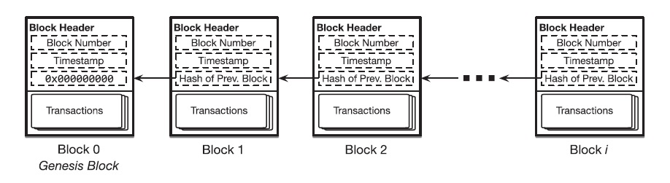
Blockchain
Decentralized and immutable platform
Technology – peer-to-peer network, distributed ledger, hashing
The changes in the state of the blockchain are recorded as transactions and gathered into blocks
Notes:
Distributed ledger is an append only log
E.g., Bitcoin, Ethereum

Slide 3

Bitcoin
Blockchain for the bitcoin cryptocurrency
UTXO model
Proof of Work algorithm
Merkle trees used to verify the authenticity of a transaction.

Slide 4
UTXO
Each transaction spends output from prior transactions and generates new outputs that can be spent by transactions in the future.
E.g., Alice 12.5 BTC → transaction sending 1 BTC to Bob → Alice receives 11.5 BTC as new UTXOs; Bob’s previous balance 2 BTC → current balance 3 BTC → Bob’s wallet keeps track of 2 UTXOs
Notes:
Let’s take a look at a simplified example of how the UTXO model works in Bitcoin transactions:
1. Alice gains 12.5 bitcoins through mining. Alice’s wallet is associated with one UTXO record of 12.5 bitcoins.
2. Alice wants to give Bob 1 bitcoin. Alice’s wallet first unlocks her UTXO of 12.5 bitcoins and uses this whole 12.5 bitcoins as input to the transaction. This transaction sends 1 bitcoin to Bob’s address and the reminder of 11.5 bitcoins is sent back to Alice in the form of a new UTXO to a newly-created address (owned by Alice).
3. Say there was another UTXO of 2 bitcoins associated with Bob prior to step 2, Bob’s wallet now shows that his balance is 3 bitcoins. Bob’s wallet now keeps track of two UTXOs: one from before and another from the transaction in step 2. Each UTXO needs to be unlocked if Bob wishes to spend them.

Slide 5
Proof-of-Work
Calculation of a nonce
Hash(B + nonce) < t, where B denotes the contents of the block, nonce a random variable and t is an upper threshold
Notes:
Nonce is a random value

Slide 6
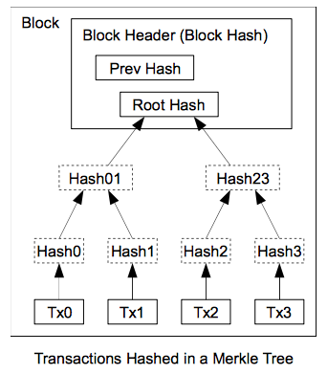
Merkle Tree
Represents a block in the chain
Uses the concept of hashing
Only the root hash is stored in the block.
Notes:
Each transaction present in the block has a hash; all converge to the root hash

Slide 7

Ethereum
Turing complete blockchain, uses the EVM
Accounts/balance model
Proof-of-work algorithm
Smart contract creation
Notes:
Turing Complete – execute code of unbounded complexity
Accounts model – similar to a debit card transaction
Here is a simplified example of how this model works in Ethereum:
1. Alice gains 5 ethers through mining. It is recorded in the system that Alice has 5 ethers.
2. Alice wants to give Bob 1 ether, so the system will first deduct 1 ether from Alice’s account, so Alice now has 4 ethers.
3. The system then increases Bob’s account by 1 ether. The system knows that Bob has 2 ethers to begin with, therefore Bob’s balance is increased to 3 ethers.
Uses a variant of the Merkle tree

Slide 8
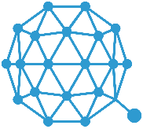
Qtum
Turing complete blockchain that uses the EVM
UTXO model
Proof-of-stake algorithm
Account abstraction layer
Decentralized Governance Protocol (DGP)
Notes:
The Account Abstraction Layer translates the UTXO-based model to an account-based interface for the EVM
UTXO model ; Scalability — Since it is possible to process multiple UTXOs at the same time, it enables parallel transaction processing.
Decentralised Governance Protocol (DGP) that allows QTUM token holders to participate in the voting and negotiation of the upgrade and iteration of the blockchain network

Slide 9
Blockchain Oracles
Used to supply data on-chain, since smart contracts cannot call the outside world.
Centralized and decentralized oracles
Human oracles, software/hardware
Consensus mechanisms for decentralized oracles. E.g., k out of n oracles
Notes:
E.g., horse race betting, smart contract to transfer funds to winners, event takes place, data that the nth horse has won the race needs to be passed on chain – done using the implementation of oracles

Slide 10
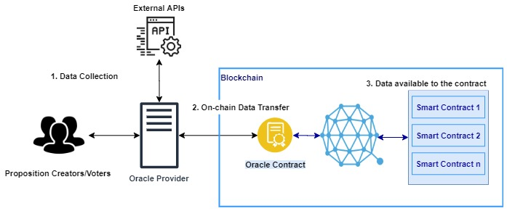
Blockchain Oracles - Architecture
Notes:
E.g., horse race betting, smart contract to transfer funds to winners, event takes place, data that the nth horse has won the race needs to be passed on chain – done using the implementation of oracles

Slide 11
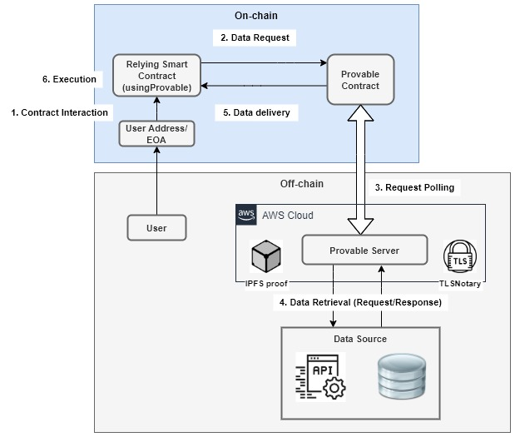
A centralized oracle - Provable
Import a .sol file provided by Provable
Inherit the usingProvable contract
E.g., provable_query(60, "WolframAlpha", "flip a coin");
Notes:
E.g., horse race betting, smart contract to transfer funds to winners, event takes place, data that the nth horse has won the race needs to be passed on chain – done using the implementation of oracles

Slide 12
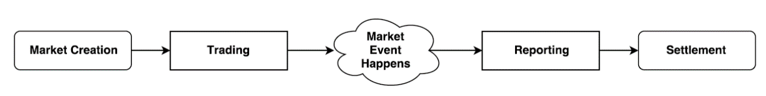
A decentralized oracle - Augur
Prediction market and decentralized oracle platform
Designated reporters
Dispute round: 7-day period
Fork: 60-day period
Notes:
Market creator submits – market, designated reporter, no-show bond, validity bond

Slide 13
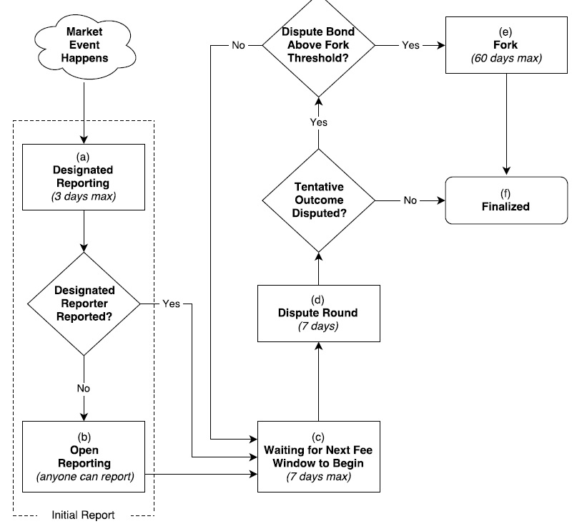
A decentralized oracle - Augur
Notes:
Validity bond and a no-show bond
Designated reporting -> dispute round -> finalized
Designated reporting -> dispute round (dispute bond > 2.5 % of the total REP) ->Fork
Winning universe, losing universe, true universe, false universe

Slide 14
A Summary of Oracles
Platform | Oracles | Consensus | Trust Model / features | Data Source(s) | Latency | Types of Oracles
Provable | single | N/A | TLS Notary, IPFS multihash | single | low | Provable Contract
TownCrier | single | N/A | Intel SGX, proofs | single | low | TownCrier Contract
Corda | single | N/A | Intel SGX | single | low | Corda code
MS Bletchley | multiple | N/A | Secure Container, Intel SGX | multiple | low | Off-chain code
Astrea | multiple | Voting/ Certification | Reward Pools, Penalties, | multiple | high | Certifiers/ Voters
ChainLink | multiple | n-of-k multi-signature | Off-chain aggregation, Reputation | multiple | high | Reporters
Augur | multiple | Voting | Reputation, Dispute windows, Forks | multiple | high | Voters
Gnosis | multiple | Voting | Centralized oracle, Ultimate oracle | multiple | high | Voters

Slide 15
Oracle ² - Architecture
Oracle contract
Relay Server
Private blockchain
Designated Reporter(s)
REP tokens
Voters and Certifiers

Slide 16
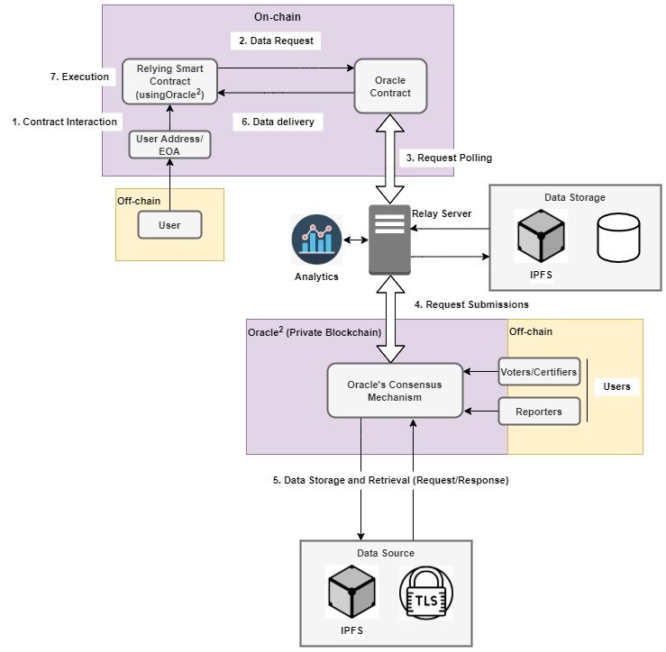
Oracle ² – Architecture

Slide 17
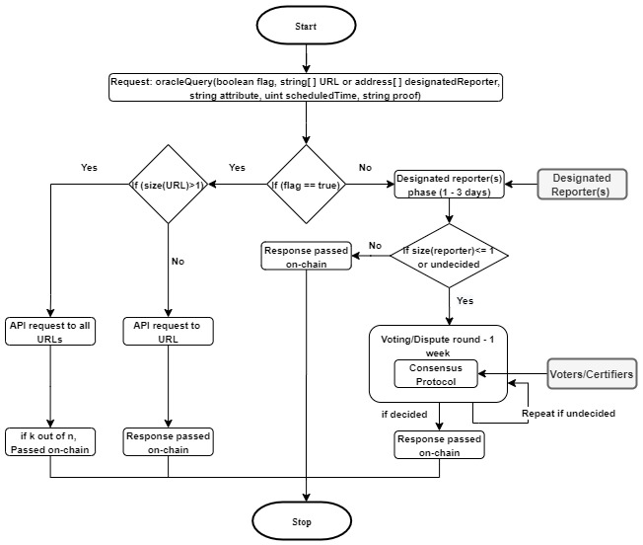
Oracle ² – Workflow
Notes:
Consider an example where the bounty submitted with a request is 2 ETH and, the participants are –
Designated reporter D1 who stakes a deposit of 2 REP – outcome O1
Voters – V1, V2 and V3 who stake deposits 4 REP, 3 REP and 2 REP respectively, - (V2 and V3 support outcome O1)
Certifiers – C1 and C2 who deposits 10 REP and 15 REP respectively – (C2 supports outcome O1)
The total REP staked as a deposit is 36 REP.
Suppose voter V1 and certifier C1 report false outcomes, then they are penalized, and their deposit is transferred to the reward pool. At this point the reward pool holds a value of 2 ETH and 14 REP. Once the final outcome is decided, the deposits made by participants who reported correct outcomes are returned together with a proportionate reward. In our case voter V2 would receive a reward (3/22) * (2 ETH + 14 REP).
Vmin and Cmin indicate minimum voters and certifiers

Slide 18
Oracle ² – Example
The bounty submitted with a request is 2 ETH and, the participants are –
Designated reporter D1 stakes a deposit of 2 REP
Voters – V1, V2 and V3 stake deposits 4 REP, 3 REP and 2 REP
Certifiers – C1 and C2 deposit 10 REP and 15 REP

Slide 19
Oracle ² – Example
The total REP staked as a deposit is 36 REP.
Suppose voter V1 and certifier C1 report false outcomes
Reward pool holds a value of 2 ETH and 14 REP.
In our case voter V2 would receive a reward (3/22) * (2 ETH + 14 REP).

Slide 20
Innovation
Flexibility
Turn-around Time
Private blockchain
Why Qtum? Tokens
Notes:
Flexibility - Our oracle makes it possible for oracle contracts to choose between a centralized and a decentralized service.
Turn-around Time - Together with flexibility comes an opportunity to improve the turn-around time of responses to requests. Also, the techniques of micro-decentralization and macro-decentralization helps reduce the response time by making it possible for multiple reporters to submit data during the designated reporter phase, to reach consensus
Private Blockchain – saves costs; transactions on a public blockchain and computation become costly
Qtum Blockchain? – helps with token creation; which can be used to stake deposits during voting and certification.

Slide 21
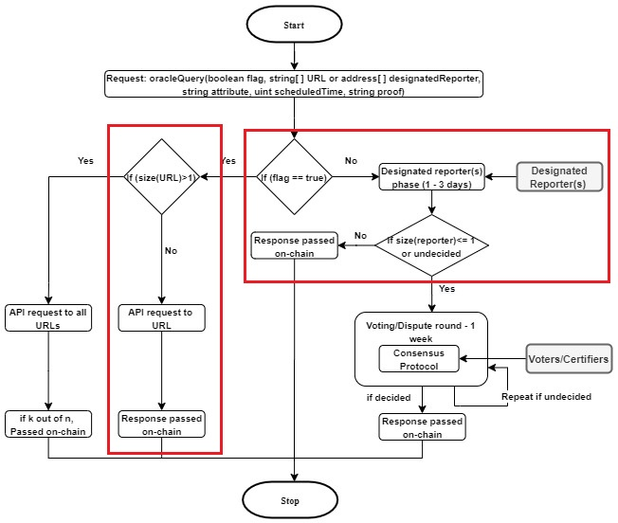
Implementation
Notes:
Centralized component – uses a central server to make API requests and pass the data on-chain
Decentralized component – uses a UI to pass data on-chain

Slide 22
Implementation – On-chain
Smart contract
Stores the state of the requests and data submitted by oracles
struct Request {
bool api; //centralised or decentralised service
uint id; //request id
string source; //source url
string attribute; //json attribute (key) to retrieve in the response
address contractAddress; // address of the requesting contract to return the value
string finalOutcome; //value from key
mapping(uint => string) outcomes; //data provided by the oracles
mapping(address => uint) qtum; //0=oracle hasn't voted, 1=oracle has voted
}

Slide 23
Implementation – On-chain
Implements a k out of n consensus mechanism.
i.e., if k out of n oracles report identical values response is passed to the relying contract.
Functions – createRequest(), updateCentralizedRequest(), updateDecentralizedRequest() and callback()
Notes:
createRequest() – used to create an oracle request.
updateCentralizedRequest() – used by oracle providers to supply data to the oracle contract
Callback() – overridden by the relying contract

Slide 24
Implementation
Centralized Component (off-chain)
Node.js, PostgreSQL, web3
Node.js used to connect to the database, make http requests
Web3 is used to poll the oracle contract for events, send signed transactions
Notes:
The database stores the requests that have been serviced.

Slide 25
Implementation
Decentralized Component (off-chain)
Web3, HTML, CSS, Javascript
Web3 is used to poll the oracle contract for events, send signed transactions
HTML used to design the UI

Slide 26
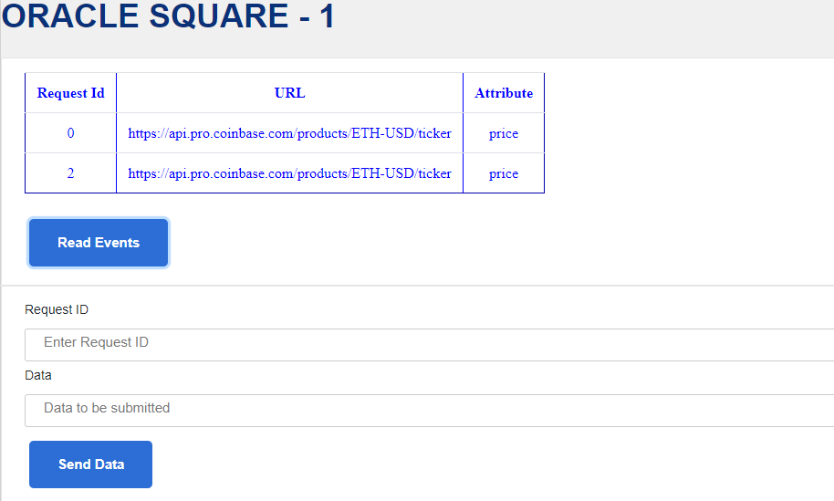
Implementation
Notes:
Only requests that require a decentralized service are populated in the table

Slide 27
Why the Qtum blockchain?
UTXO Model
Account Abstraction Layer
Decentralized Governance Protocol (DGP)
Token Creation
Notes:
Flexibility - Our oracle makes it possible for oracle contracts to choose between a centralized and a decentralized service.
Turn-around Time - Together with flexibility comes an opportunity to improve the turn-around time of responses to requests. Also, the techniques of micro-decentralization and macro-decentralization helps reduce the response time by making it possible for multiple reporters to submit data during the designated reporter phase, to reach consensus
Private Blockchain – saves costs; transactions on a public blockchain and computation become costly
Qtum Blockchain? – helps with token creation; which can be used to stake deposits during voting and certification.

Slide 28
Future Works
Threat models E.g., majority certifiers belong to the top 20 percent of bad performers
Dashboard
REP token aging

Slide 29
Thank You!

